Slide 1
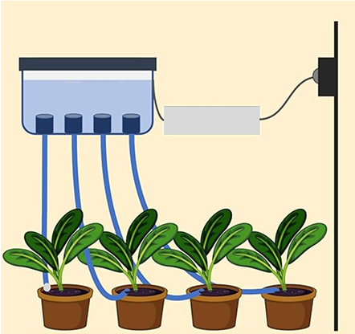
Smart Tree Care System
Monitoring & Automated Care for Healthy Trees
Farjan Ahmmed
232-35-738

Slide 2
Problem Statement & Solution
Introduction
Trees are essential for ecological balance, air purification and urban landscaping. Ensuring proper tree care is challenging due to inconsistent watering and lack of real-time monitoring. This project automates tree care using a Smart Tree Care System to optimize water usage and ensure healthier tree growth.
Solution
A system that monitors soil moisture and automatically waters trees when needed.
Issues in Tree Care
Underwatering → Dehydration and poor growth.
Overwatering → Root rot and water wastage.
Manual watering is inefficient and labor-intensive.

Slide 3
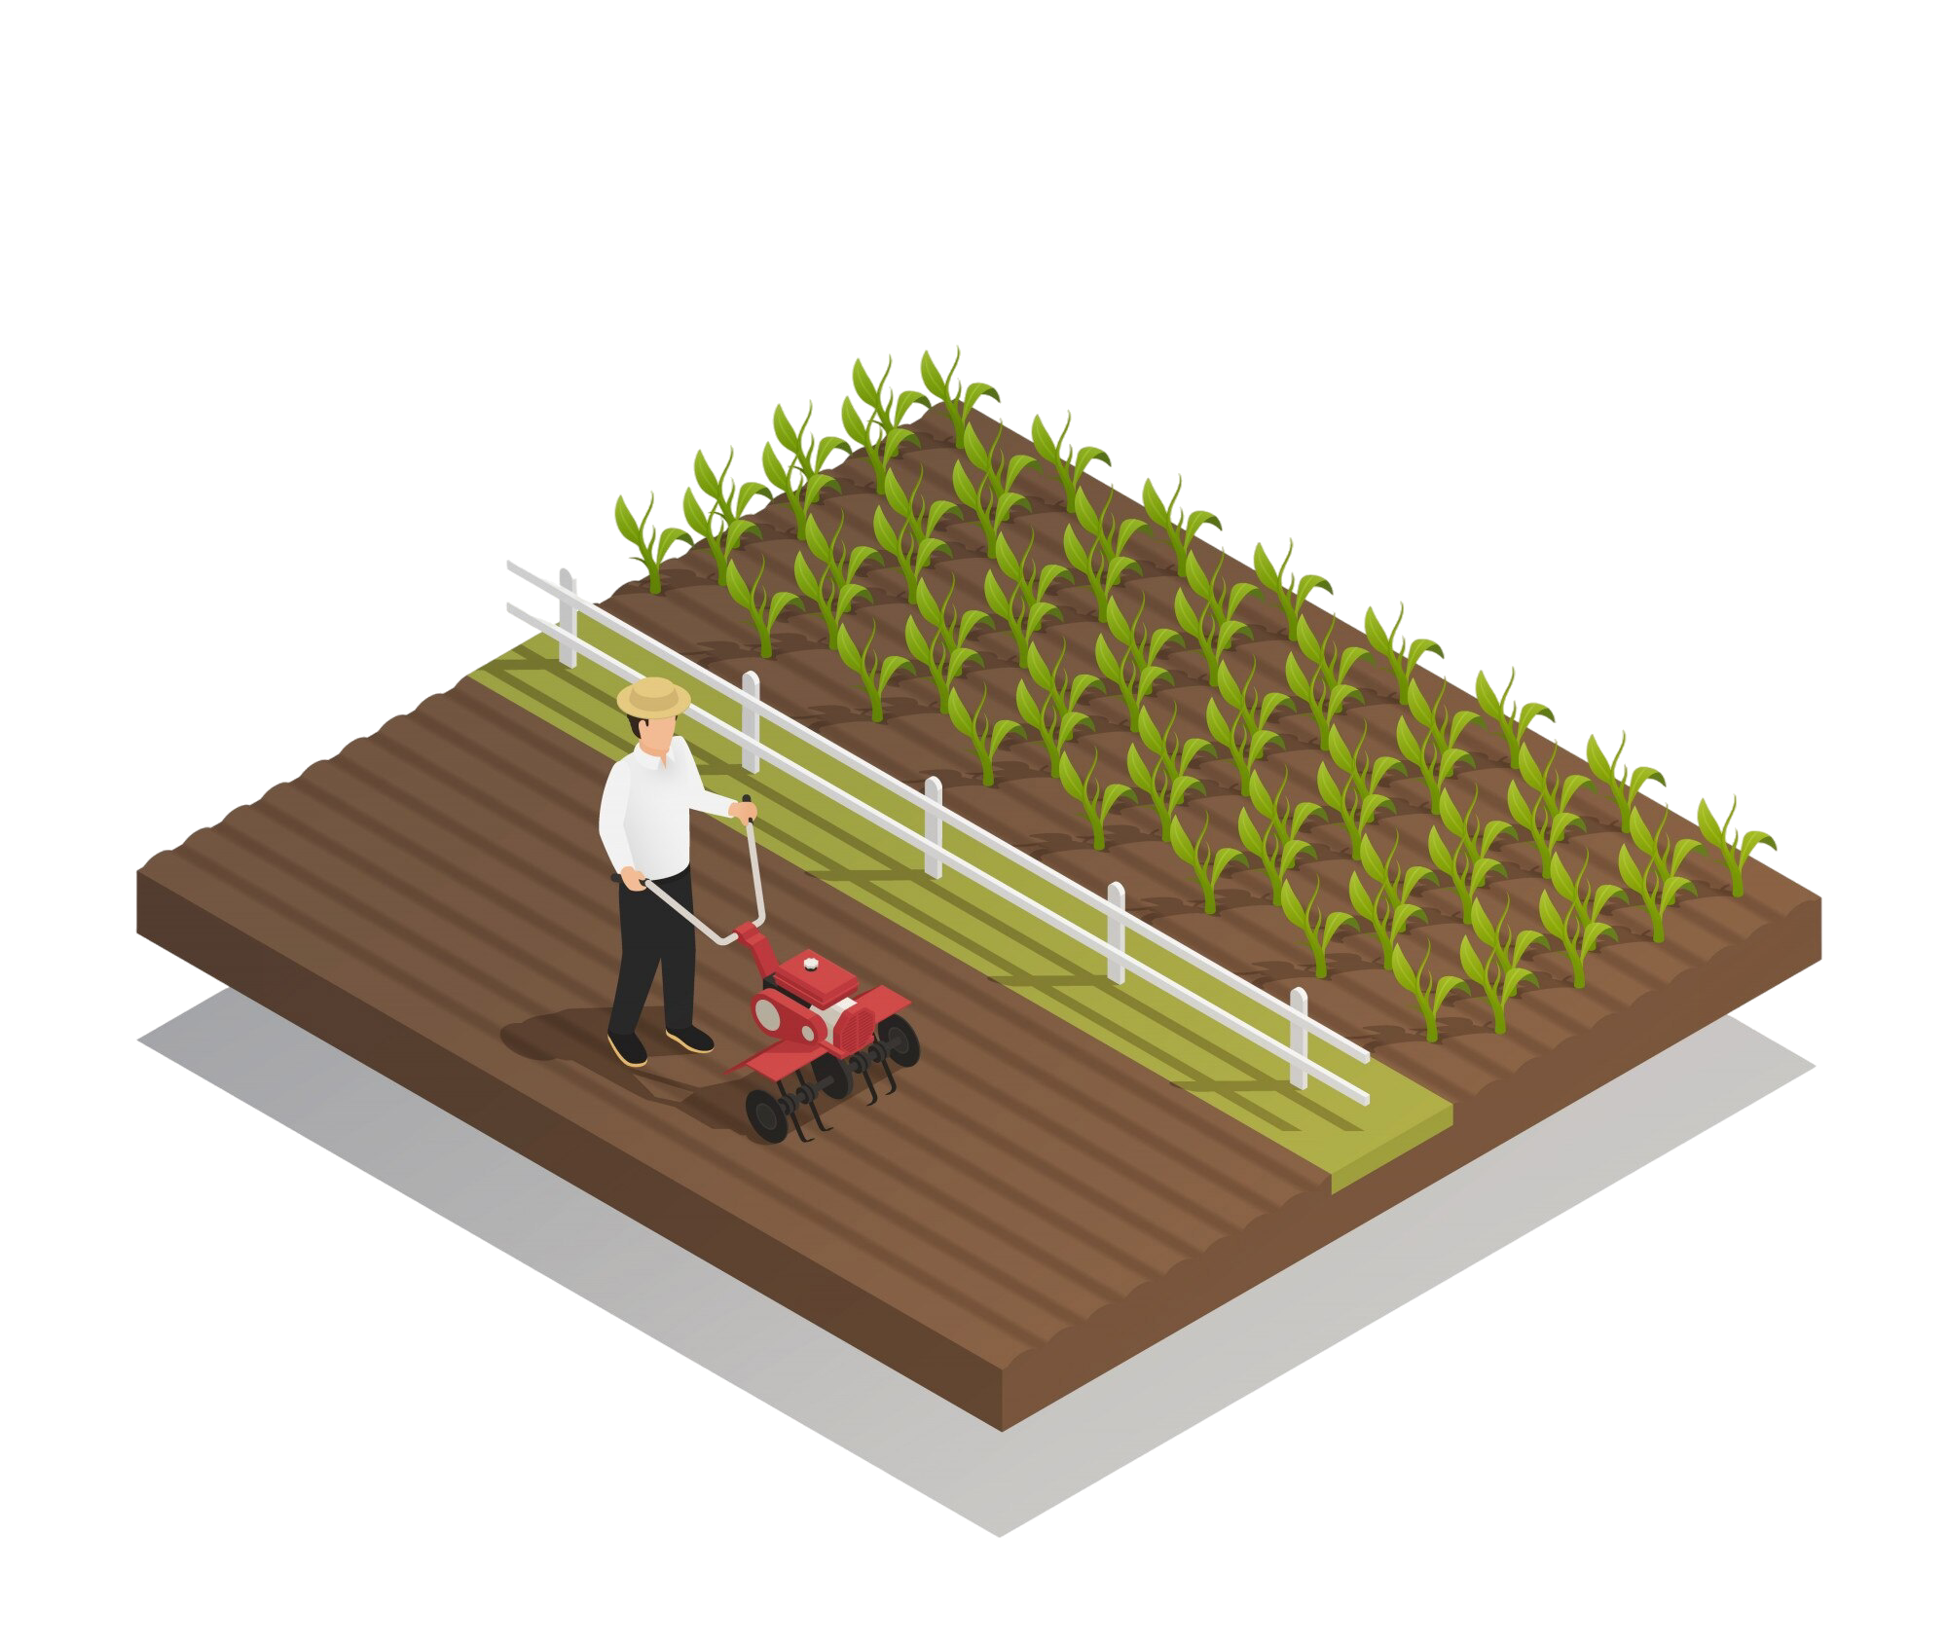
Project Objectives
1
Real-Time Monitoring
Monitor soil moisture levels in real time.
2
Automated Watering
Automatically water the tree when soil moisture drops
below a threshold.
3
Optimal Tree Health
Prevent overwatering and underwatering.
4
Cost-Effective Solution
Use a cost-effective and energy-efficient approach.

Slide 4
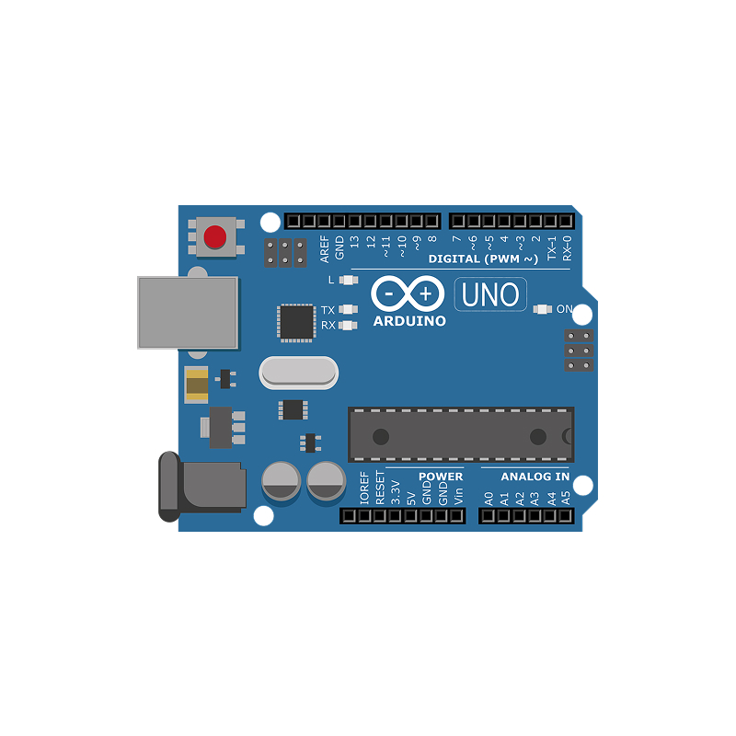
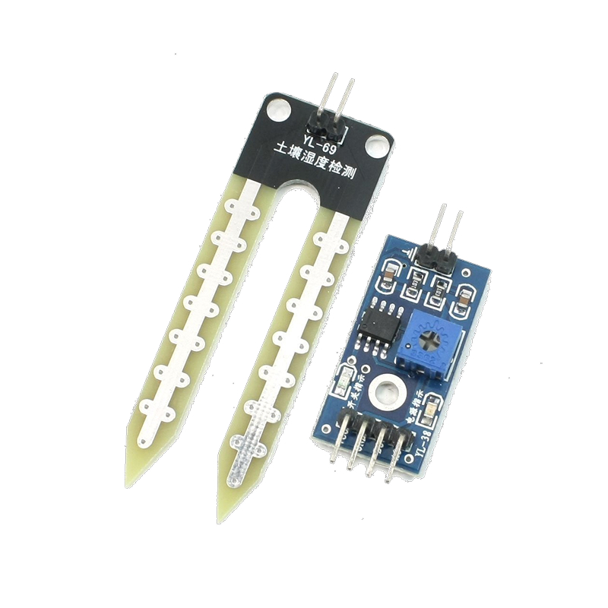
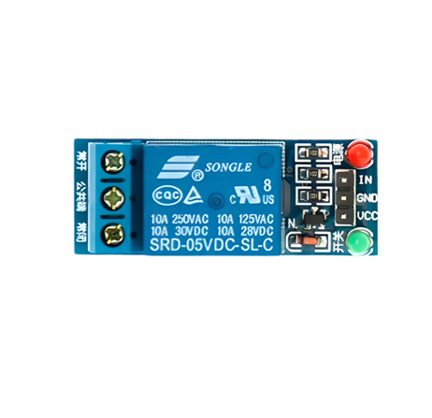
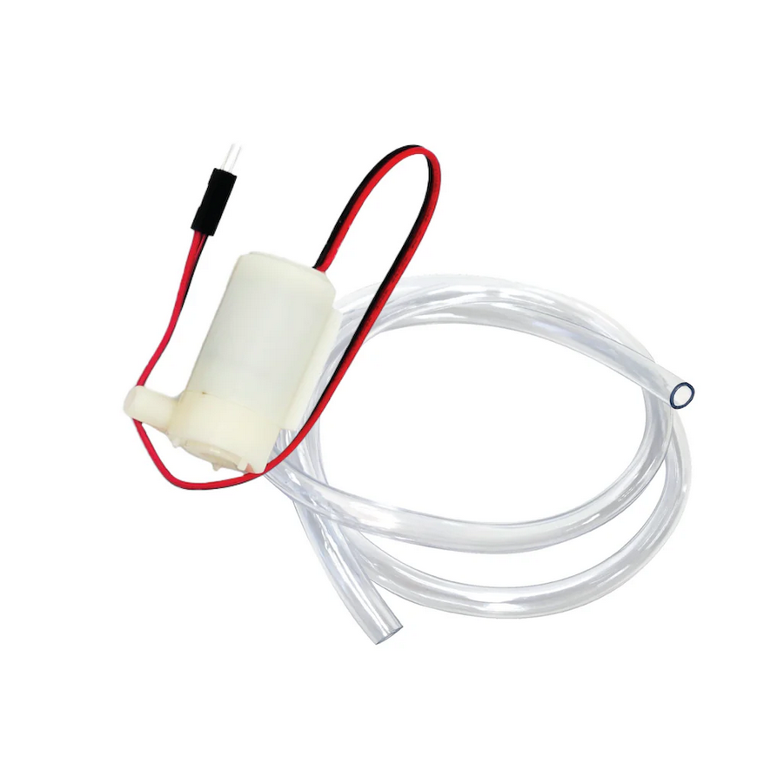
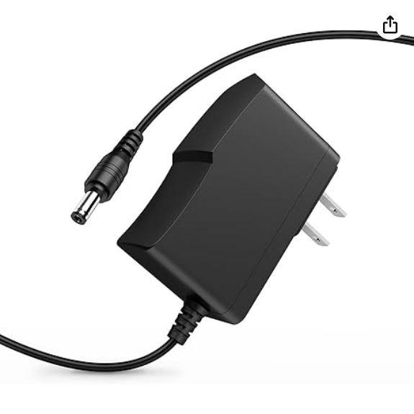
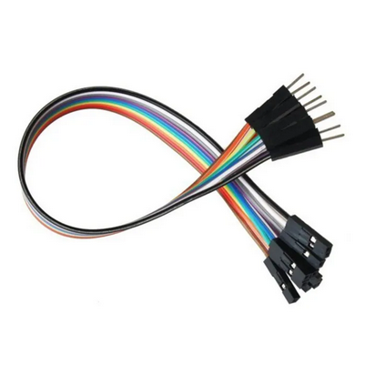
System Components
Arduino UNO
Soil Moisture Sensor
5V Relay
Jumper Wires
5V Water Pump
2X Charger

Slide 5
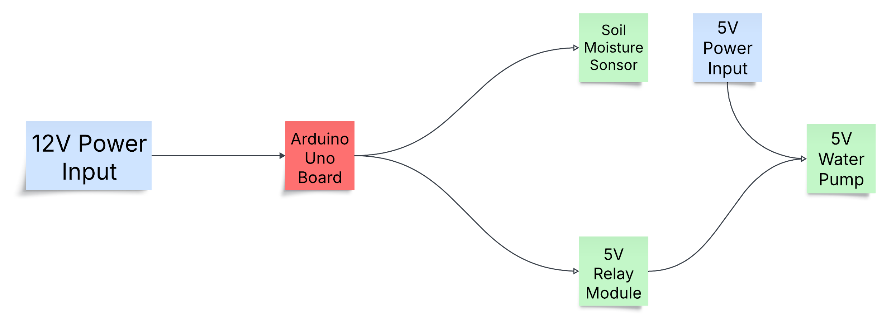
Proposed Methodology
Soil Moisture Monitoring – Sensor measures moisture level.
Data Processing & Decision Making – Arduino compares data with a predefined threshold.
Activation of Water Pump – If moisture is low, relay activates the pump.
Automatic Deactivation – Pump stops once optimal moisture is reached.
Continuous Monitoring – The process repeats automatically.

Slide 6
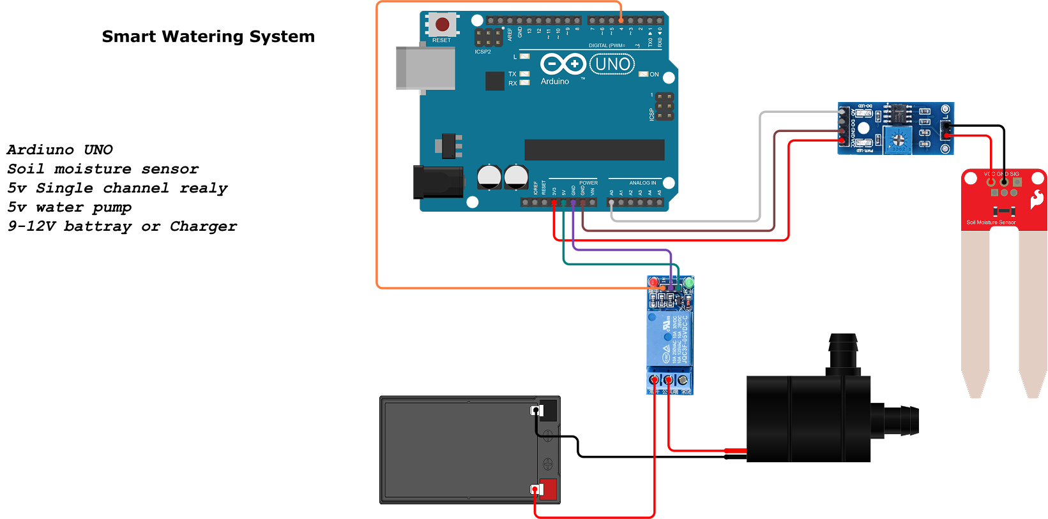
Circuit Diagram

Slide 7
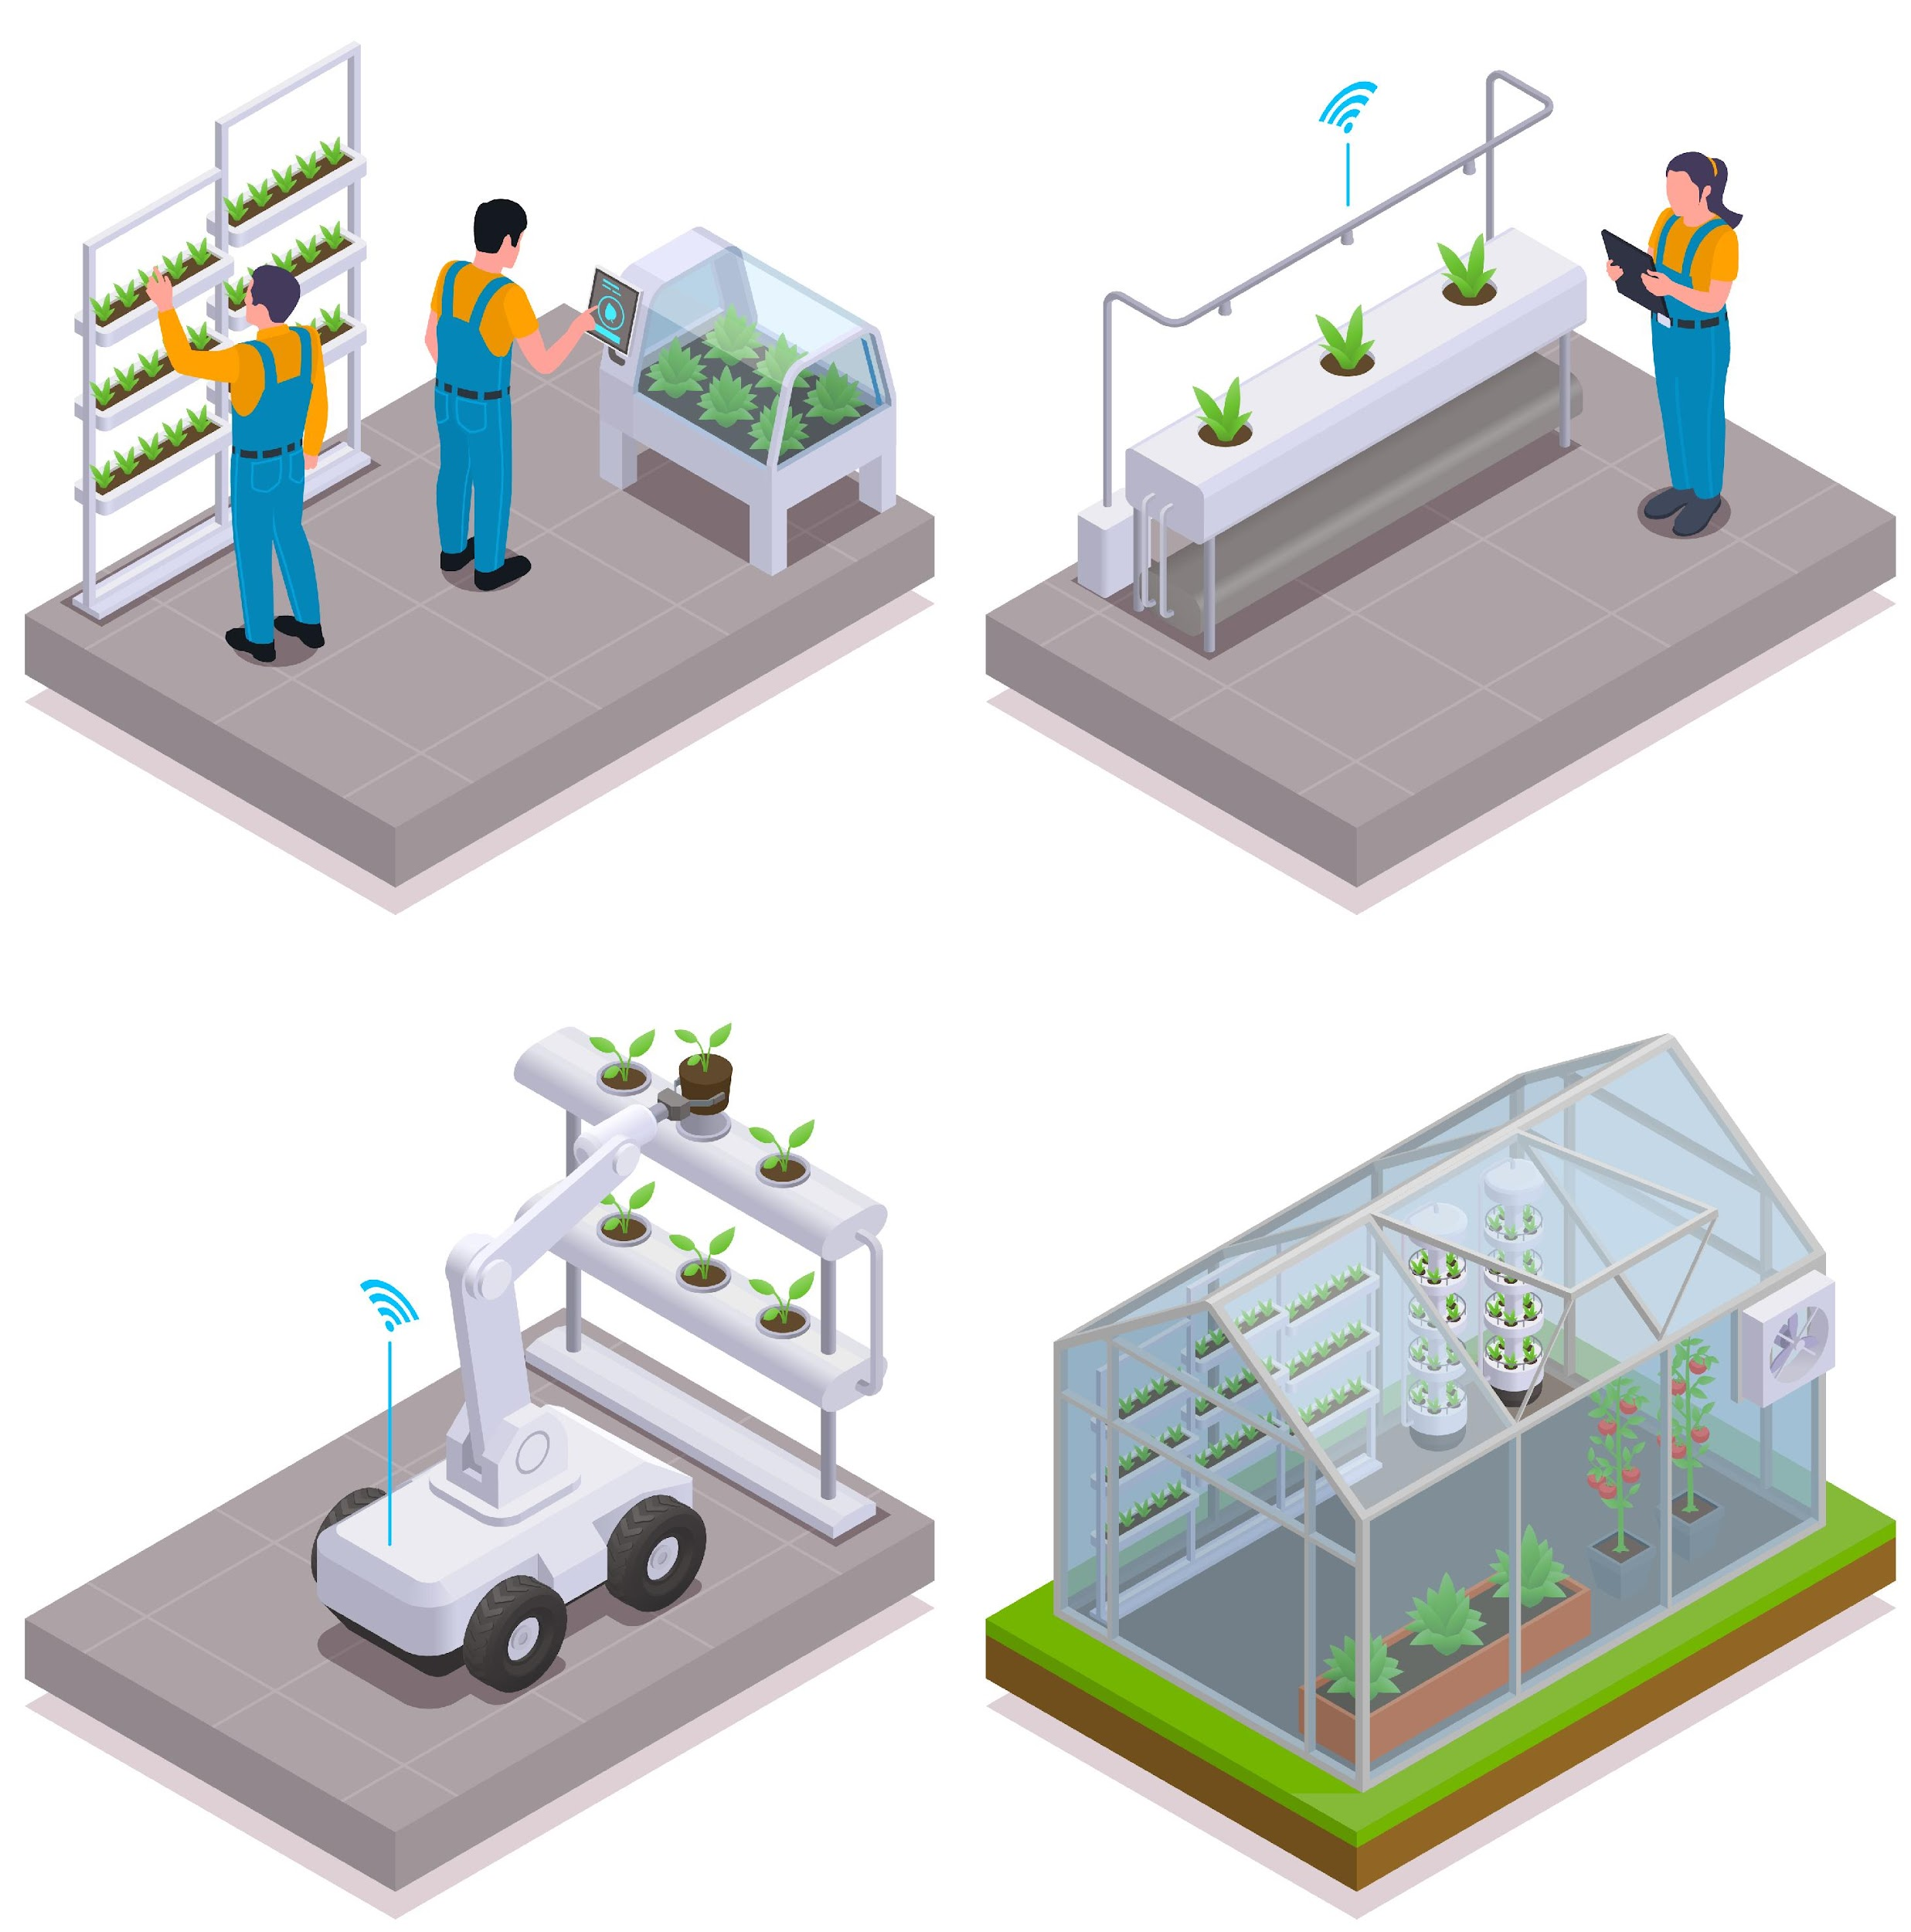
Advantages & Expected Outcomes
Efficient water management with minimal wastage.
Automated irrigation for tree health.
Water conservation through optimal cycles.
Reduces manual labor in tree maintenance.
Scalable for different environments (gardens, urban forestry, agriculture).

Slide 8
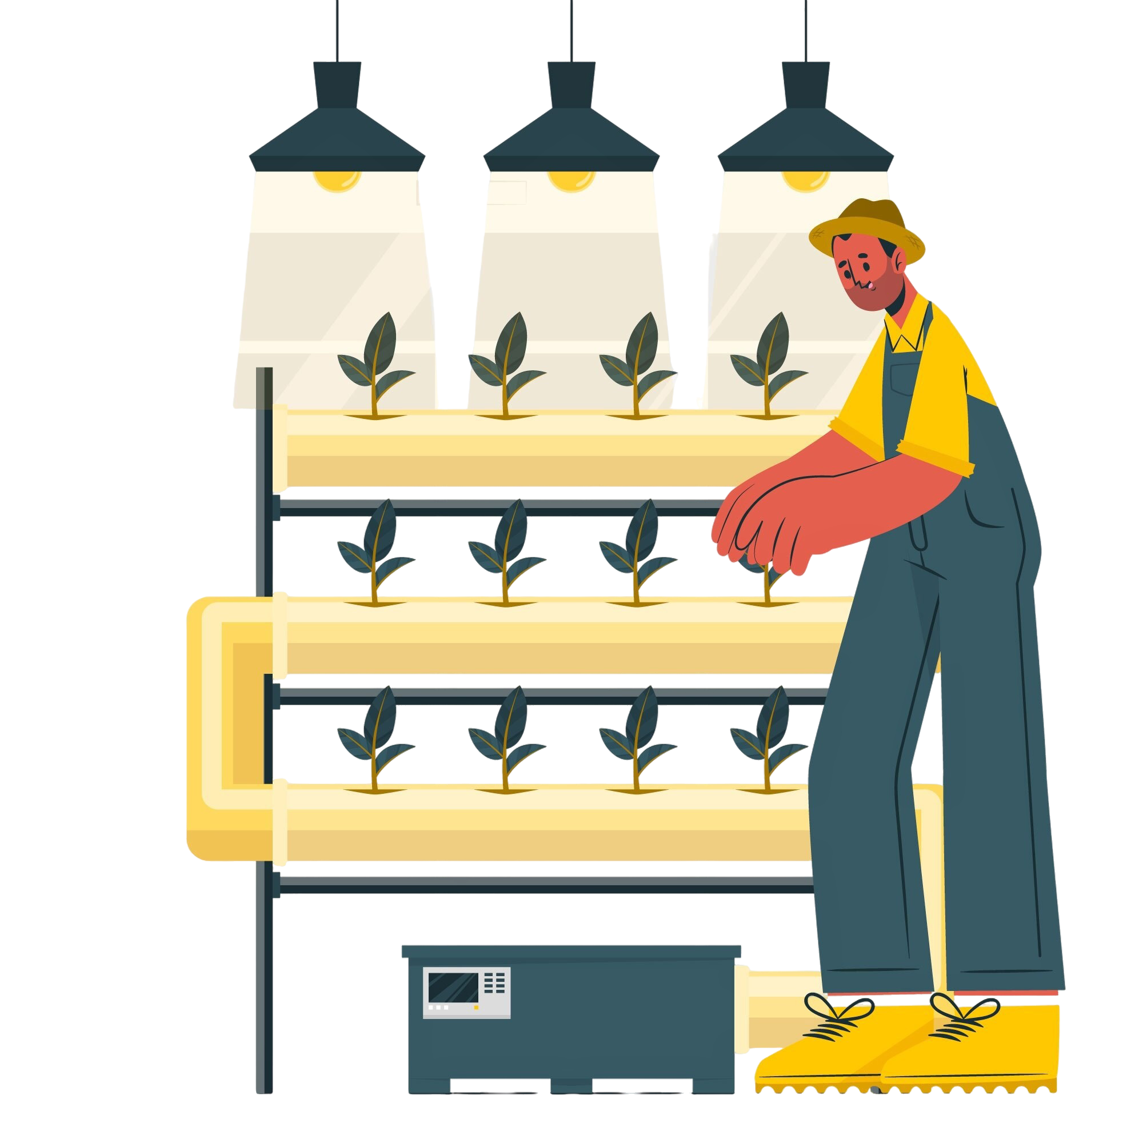
Precautions
Wiring & Insulation
Ensure secure and insulated connections.
Waterproofing
Protect components in a waterproof enclosure.
Voltage Management
Use correct power sources.

Slide 9




Benefits of the System
Sustainable
Cost-Effective
1
2
Efficient water usage.
Reduces manual labor.
Automated
4
3
Scalable
Minimal human intervention.
Adaptable to various environments.

Slide 10
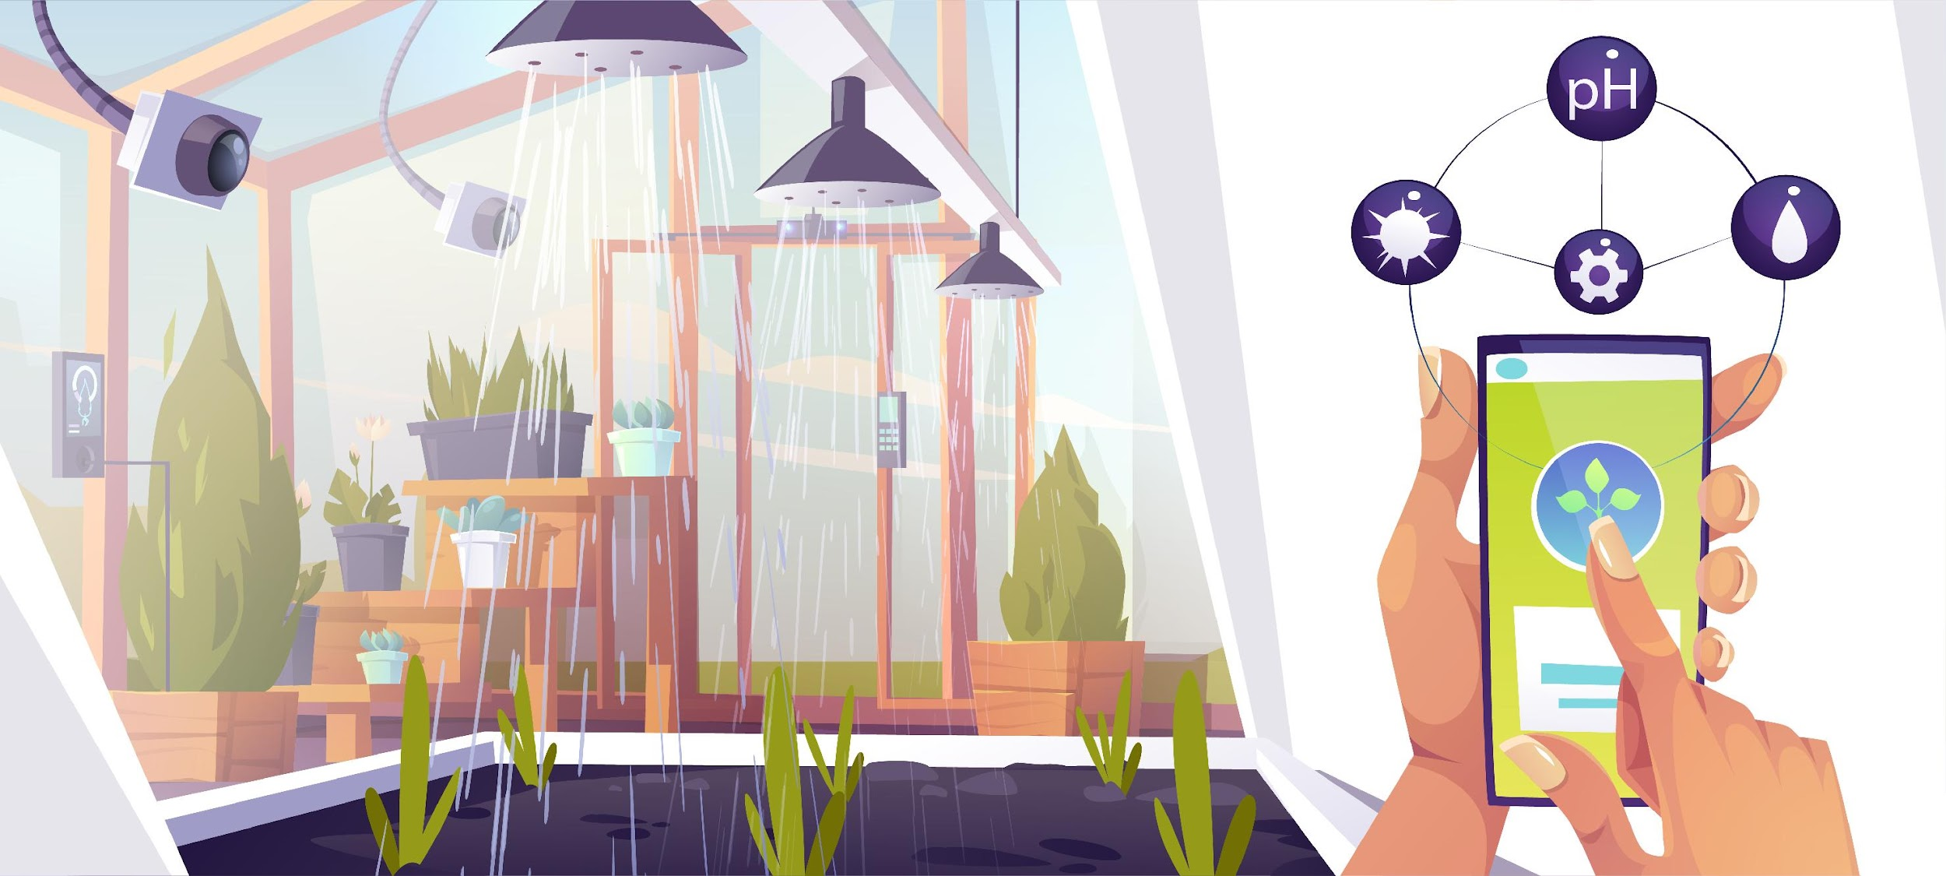
Conclusion
The Smart Tree Care System is an innovative solution for sustainable tree care. By automating irrigation and monitoring soil moisture in real-time, it ensures optimal tree health while conserving water and reducing labor. This project represents a significant step towards smart, automated and sustainable environmental care, applicable from individual gardens to large-scale plantations.

Slide 11
Thank You

